Slide 1



CODE GEN AI & CODE EXPLAINER
AI-Powered Assistant for Code Generation, Analysis, and Explanation
Presented by: Ch. Gayatri

Slide 2
INTRODUCTION
Code Gen AI & Code Explainer is an intelligent system that helps in automating code writing and understanding.
Built using AI models (LLMs), it can generate, debug, and explain code in natural language.
Integrates Streamlit, Ollama, and OCR for file-based code analysis and visualization.
Aims to make coding easier, faster, and more educational.

Slide 3
OBJECTIVES
Automate code generation and code correction.
Provide clear explanations of code logic and flow.
Identify syntax, logic, and security errors in code.
Support multiple document formats for versatile input handling.

Slide 4
CORE COMPONENTS
Streamlit: Builds a clean, interactive chat UI.
Ollama (LLM Engine): Runs local AI models like codellama, gemma, or llama3.
OCR (pytesseract): Extracts text from image-based files.
pdfplumber / python-docx: Extracts readable text from PDFs and Word files.
Pandas: Reads and displays structured CSV data.
JSON Storage: Stores conversation history securely.

Slide 5
SYSTEM ARCHITECTURE
User Input: Chat message or file upload via Streamlit.
Extraction Layer: OCR + document parsers extract text/code.
AI Layer (Ollama): LLM processes and analyzes code.
Response Engine: Generates summary, corrected code, and explanation.
Storage Layer: Saves chat history for future context.

Slide 6
WORKFLOW
User uploads a file or types a code-related query.
App extracts and processes file text.
AI model analyzes or generates code based on context.
Response streamed back with explanations and fixes.
Conversation saved for continued learning or reference.

Slide 7
STREAMLIT FEATURES
Interactive chat interface with fixed bottom input bar.
Sidebar options for model selection and chat management.
File upload button (➕) for fast access.
Real-time streaming AI responses for natural conversation.

Slide 8
OCR (OPTICAL CHARACTER RECOGNITION) MODULE
Image Files: Handled via pytesseract for OCR-based text extraction.
PDF Files: Text extracted using pdfplumber.
DOCX Files: Processed via python-docx.
CSV / TXT Files: Read directly using Pandas or file I/O.
Extracted text analyzed automatically by AI for summarization and debugging.

Slide 9
OLLAMA — LOCAL LLM INTEGRATION
Runs Large Language Models (LLMs) locally (e.g., codellama, gemma, llama3)
Works offline — no API cost or internet needed
Supports streaming responses for real-time display in Streamlit
Easy model switching: Code generation / Explanation / Debugging
Command-line:

Slide 10
ERROR HANDLING
Verifies availability of Ollama and essential libraries.
Catches exceptions from unreadable or corrupted files.
Prevents multiple LLM calls with session control.
Ensures smooth reruns and stability during chat interaction.

Slide 11
AI RESPONSE GENERATION FLOW
Receive text / code from user or OCR
Send prompt with system instructions to Ollama
Model generates:
Code summary
Error detection / fixes
Security & logic improvements
Streamlit displays formatted markdown + explanation

Slide 12
KEY FEATURES
Multi-file support (Image, PDF, DOCX, CSV, TXT)
Local AI model with Ollama
OCR integration for non-text code inputs
Chat history saved for review
Real-time streaming AI output

Slide 13
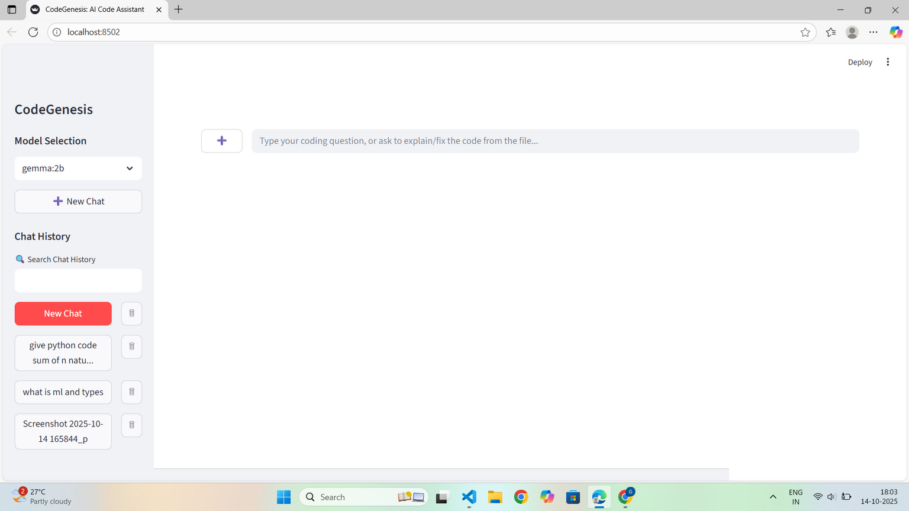
DEMO FLOW

Slide 14
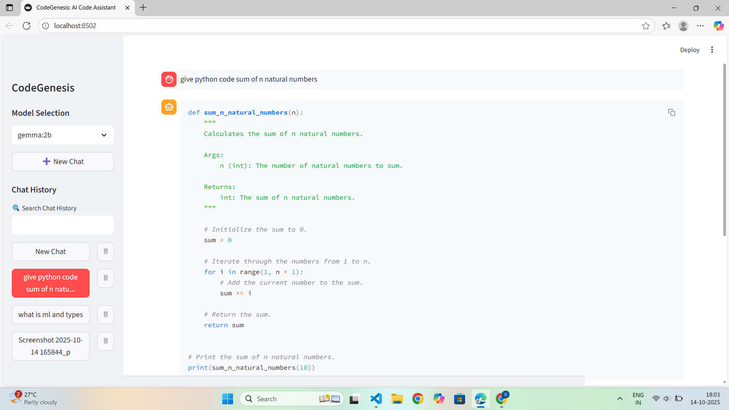

Slide 15
ADVANTAGES
No cloud dependency — full offline operation
Enhanced data privacy
Multi-language OCR capability
Scalable architecture for future AI models
Reduces developer debugging time significantly

Slide 16
FUTURE ENHANCEMENTS
Add voice input/output
Multi-model fusion (combine Ollama + OpenAI APIs)
Integrate code execution sandbox
Deploy as desktop or web SaaS app

Slide 17
CONCLUSION
Code Gen AI & Code Explainer bridges human + AI coding skills
Streamlit + Ollama + OCR = Smart Autonomous Code Assistant
Enhances developer productivity and learning
Future-ready AI coding platform

Slide 18
THANK YOU

